Slide 1
How to create a R Markdown file in R Studio

Slide 2
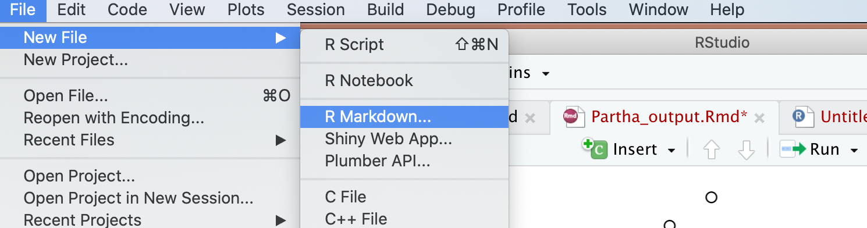
Steps to create the R Markdown File and create the Output:
Step 1: Open R Studio → Go to File Menu → Select New File → Choose the Option R Markdown

Slide 3
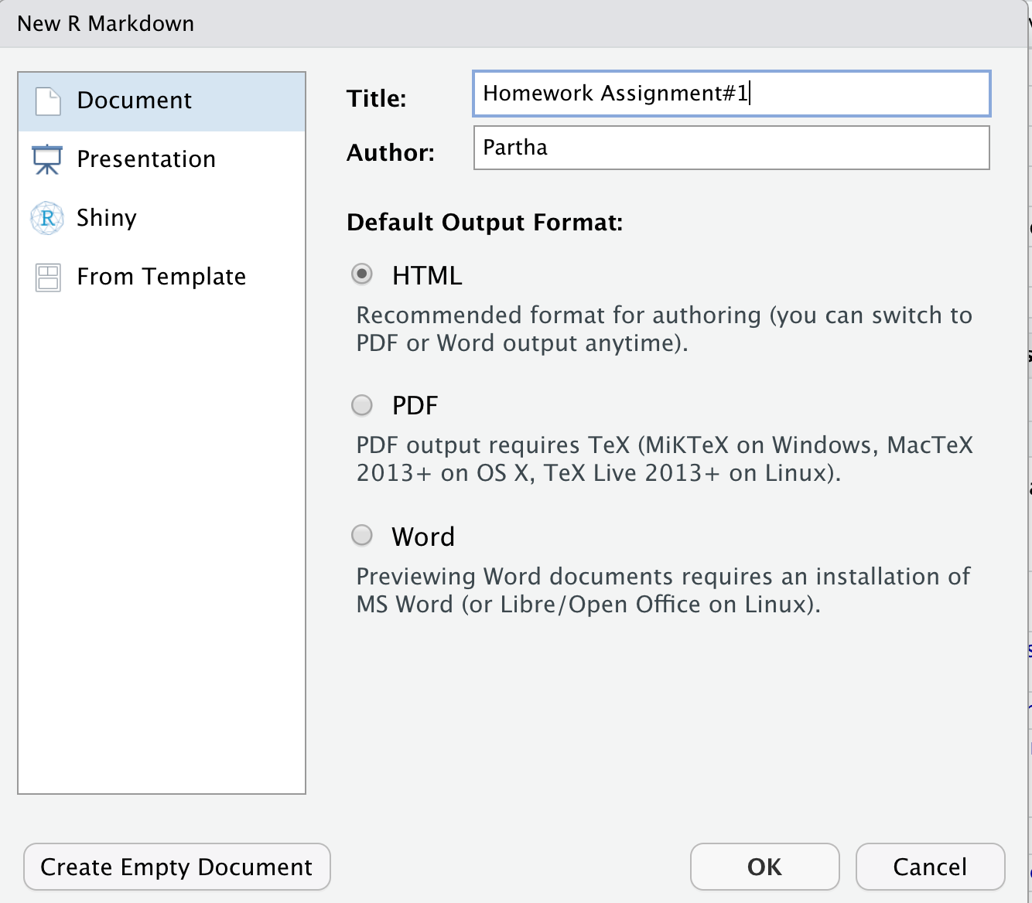
Step 2: You will get this popup window.
Enter the Title, author, Output format options and click OK.

Slide 4
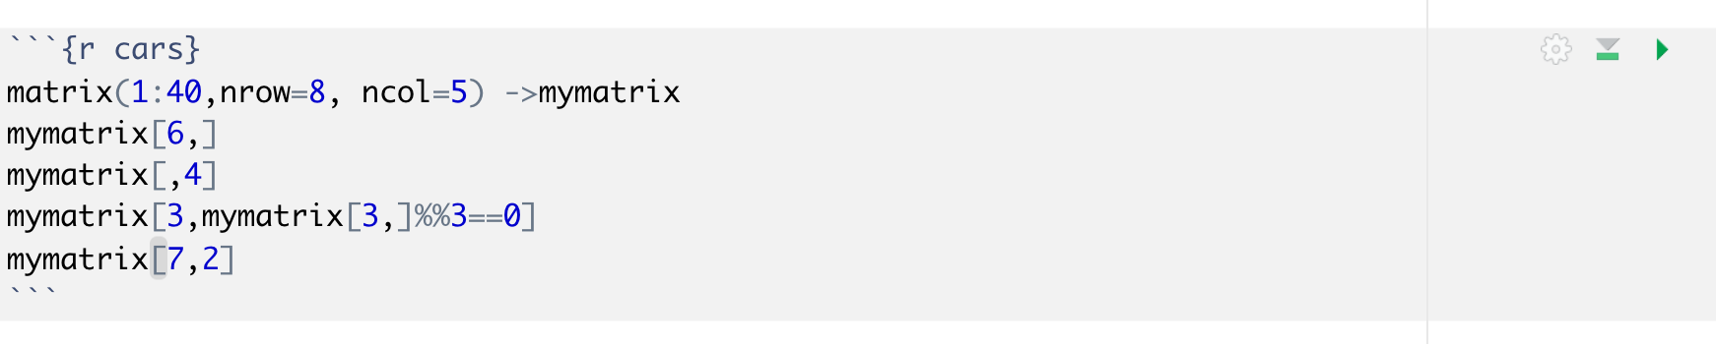
Step 3: Enter the commands from the assignment question.
All the steps required for each question in one chunk and Choose the Option “Run the Entire Chunk”
Run the current chunk

Slide 5
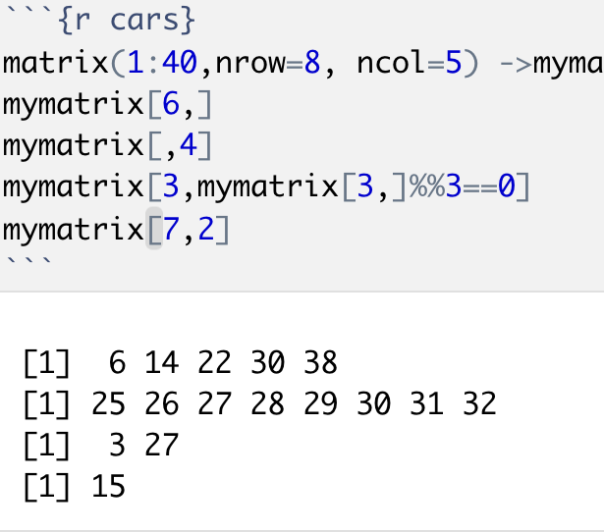
Step 4: You will see the output below the chunk of commands

Slide 6
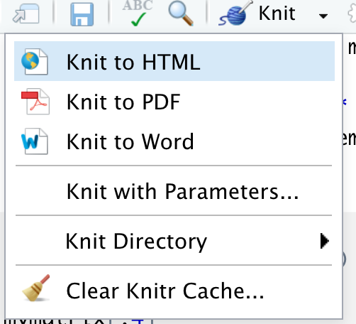
Step 5: Click the dropdown Knit and select “Knit to HTML”

Slide 7
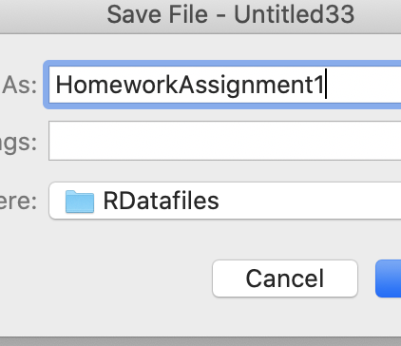
Step 6: You will get the popup to save the file. Enter the desired filename without any extension and save
it in the required folder.

Slide 8
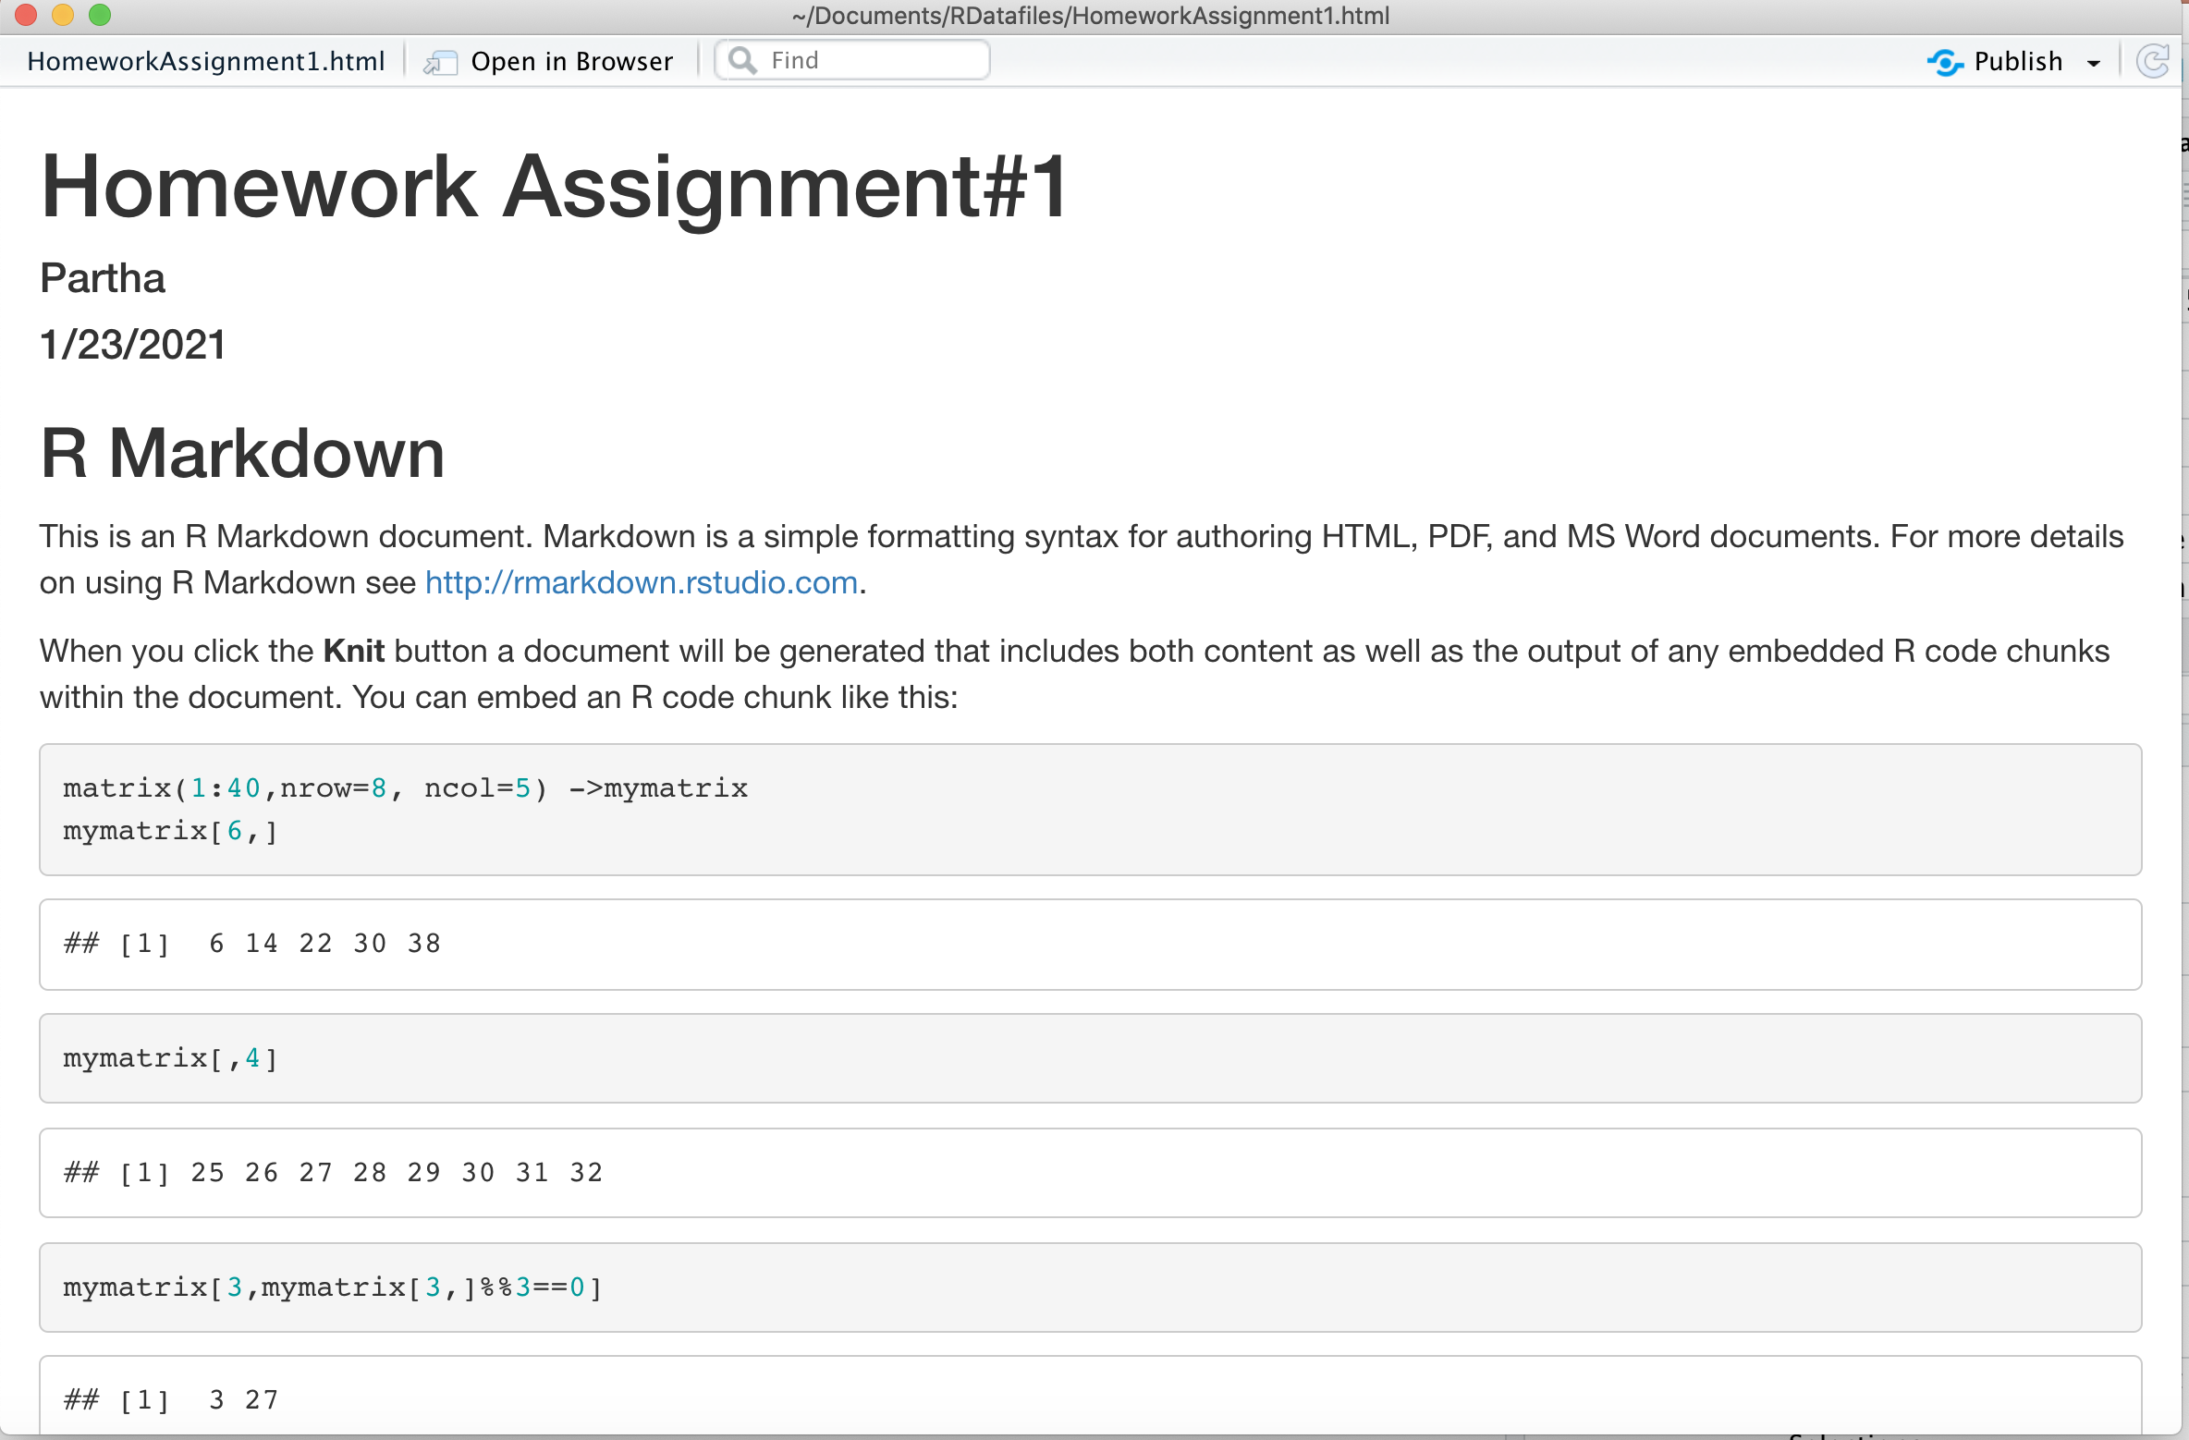
Step 7: This will create both the .RMD file and .HTML. File and open up the .HTML file.
Now you can attach this .HTML file to the Assignments in canvas and submit it

